Slide 1
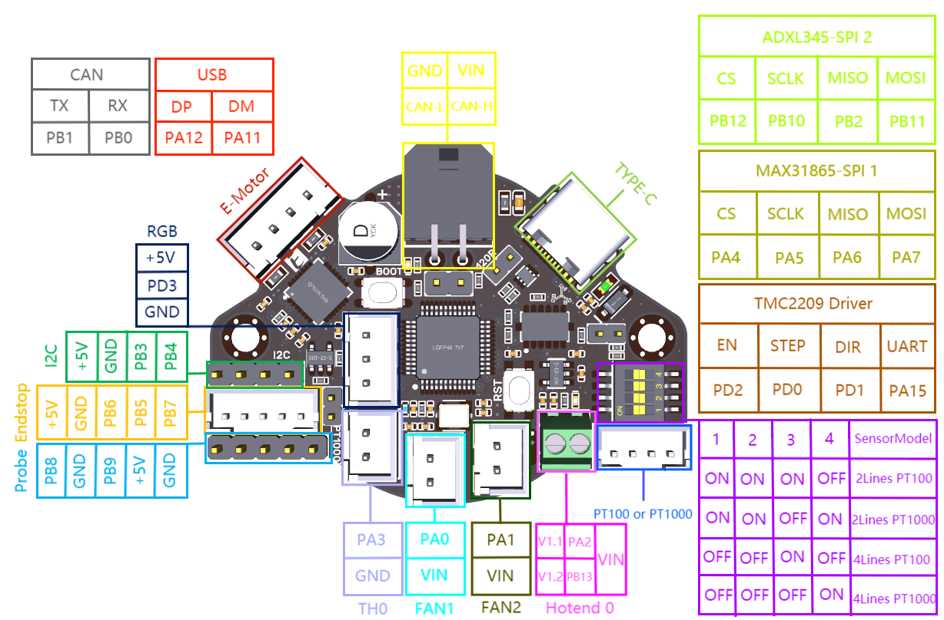
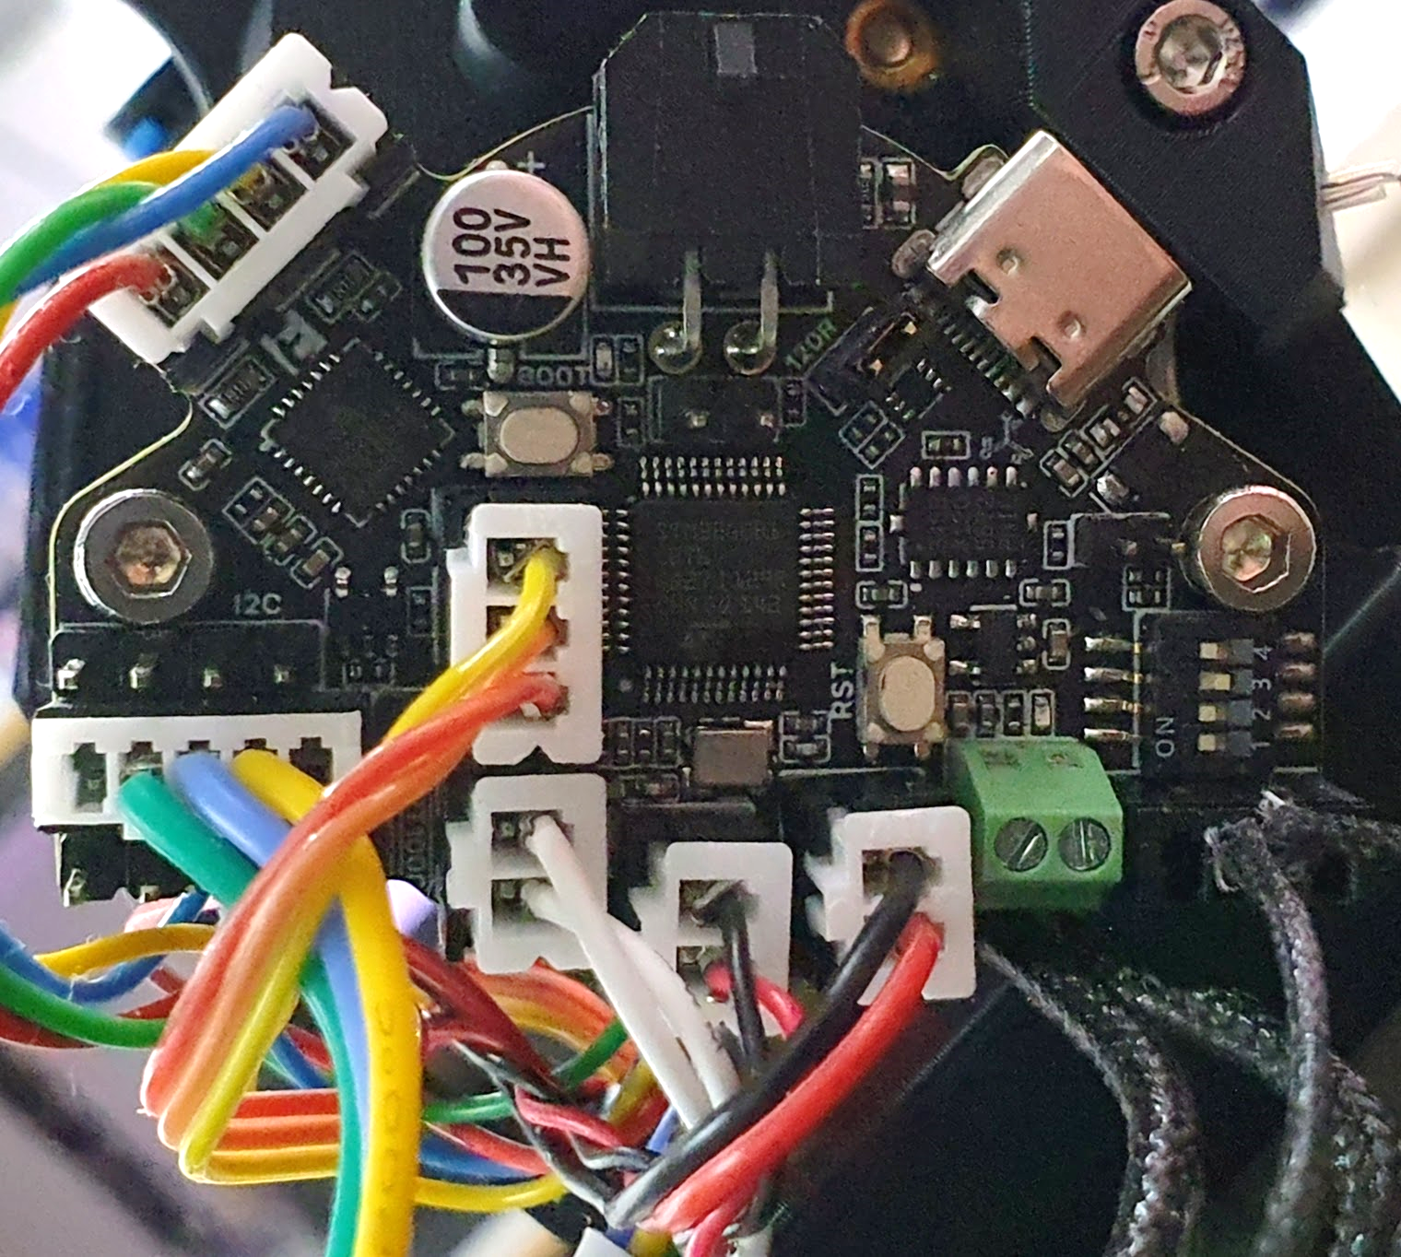
Neo LEDs
Filament motor
X (PB6) & Z (PB5) endstops
Chamber thermistor
Part fan
Hotend fan
Heater
Hotend thermistor

Slide 2
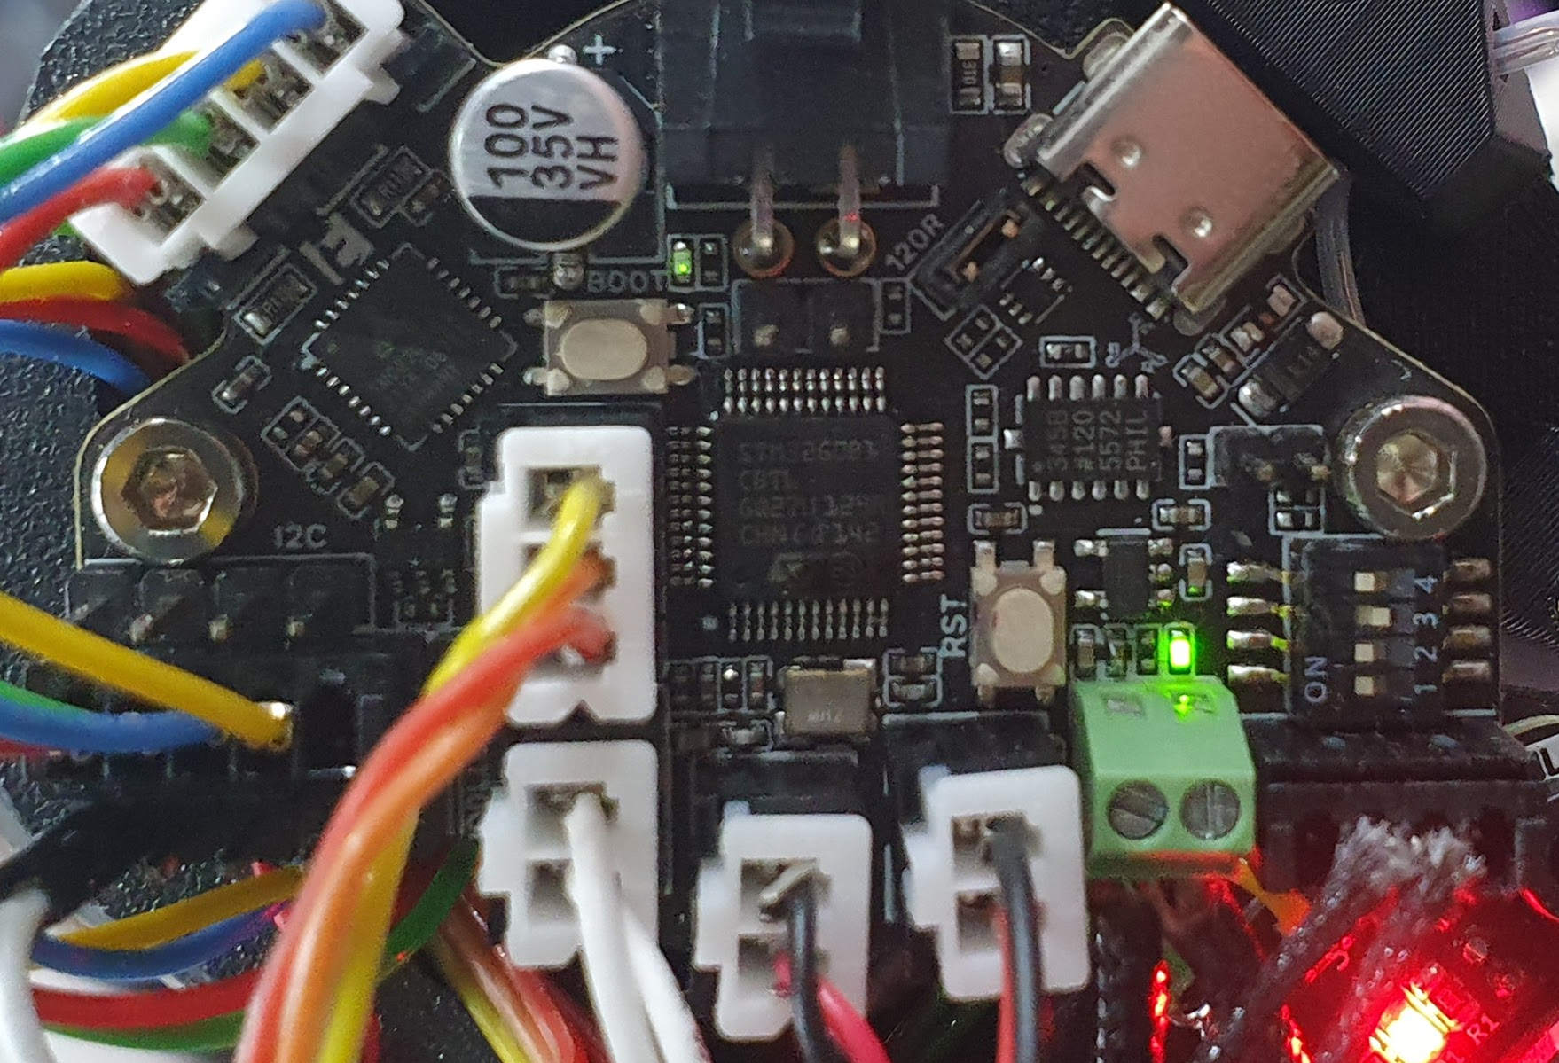
Neo LEDs
Filament motor
X (PB6) & Z (PB5) endstops
Hotend fan RPM
Chamber thermistor
Part fan
Hotend fan
Heater
Hotend thermistor

